Slide 1


+++ Live +++ +++ Live +++ +++ Live +++
Welcome
to
Software Engineering
Lesson WS2021/2022
Starting at 14:15
survey

Slide 2

+++ Live +++ +++ Live +++ +++ Live +++
The rule No1
Keep your camera on

Slide 3

+++ Live +++ +++ Live +++ +++ Live +++
Software Engineering
WS-2020-2021
Lesson Mo. 14.15-17.45 h Lab: Tue. 14.00-16.00 h
Room 8-103
https://www.linkedin.com/groups/8689804/

Slide 4


Hierarchical Temporal Memory
Damir Dobric
Microsoft PTSP (Partner Technical Solution Specialist) Microsoft Most Valuable Professional
Blog
Twitter
damir.dobric@daenet.com b-dadobr@microsoft.com

Slide 5
AI / ML
Where we are

Slide 6
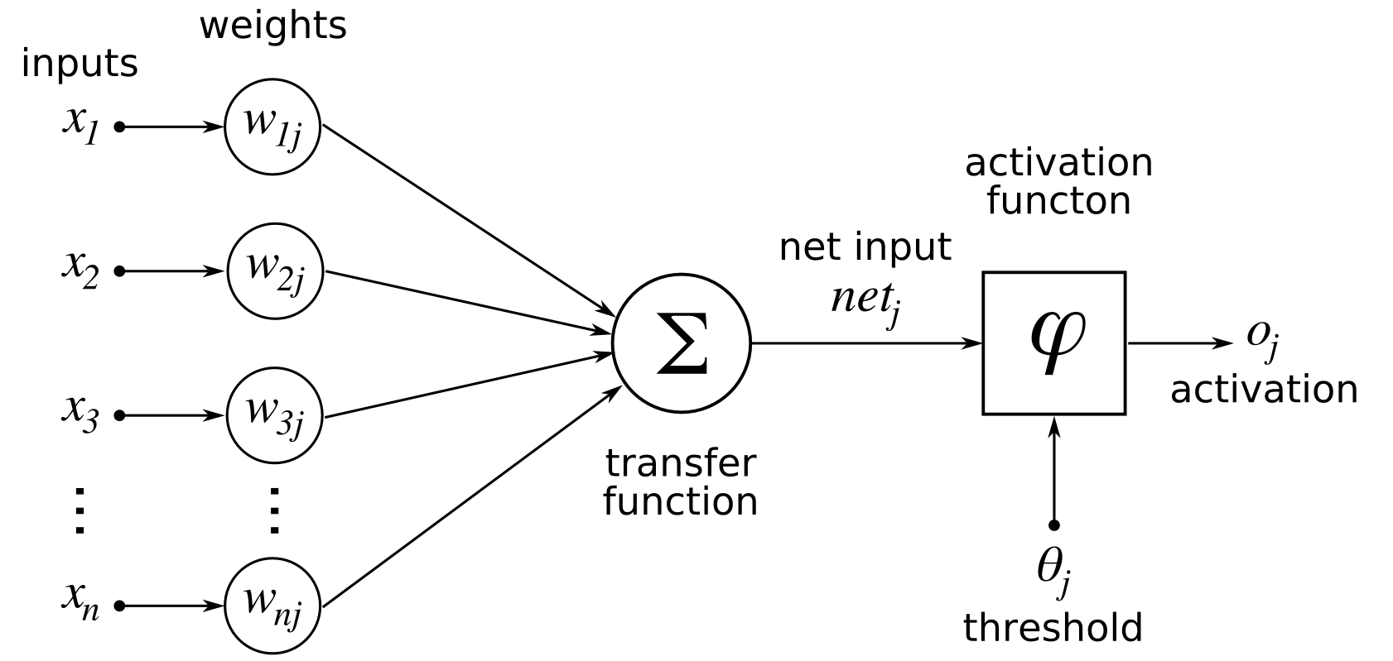
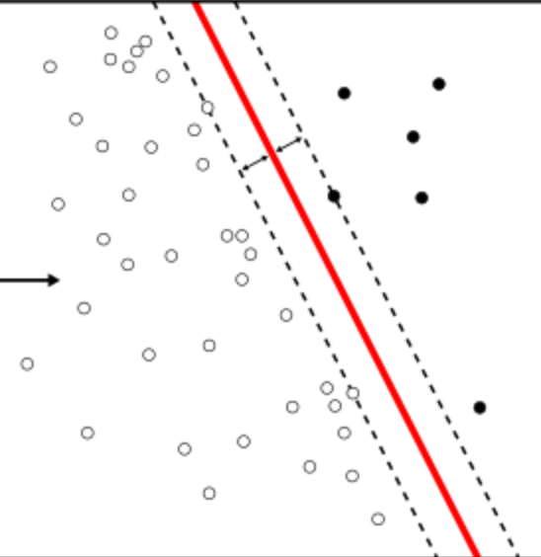
Perceptron
e = xW.

Slide 7
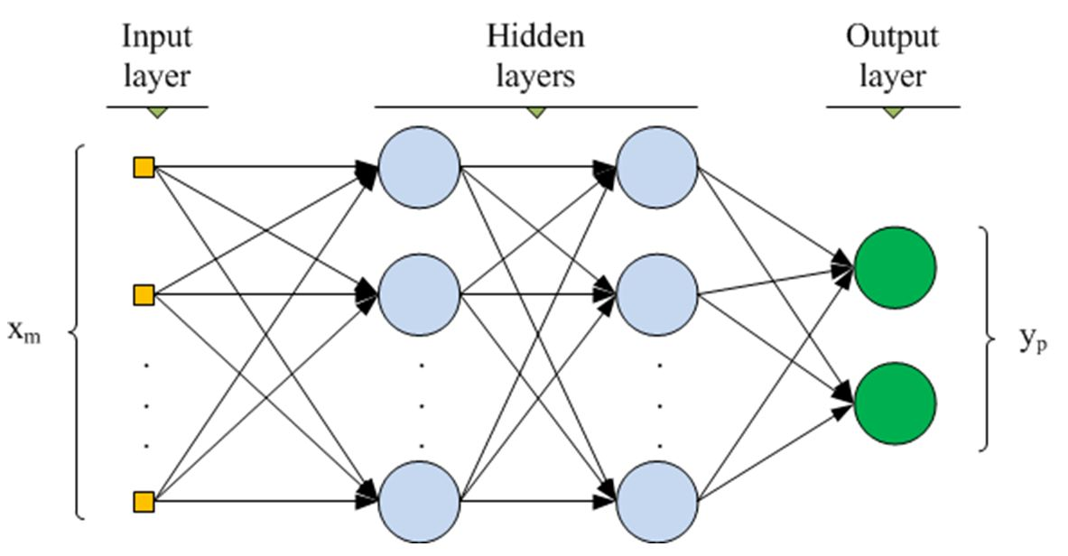
Multilayer ANN
www.cs.us.es/~fsancho/?e=135

Slide 8
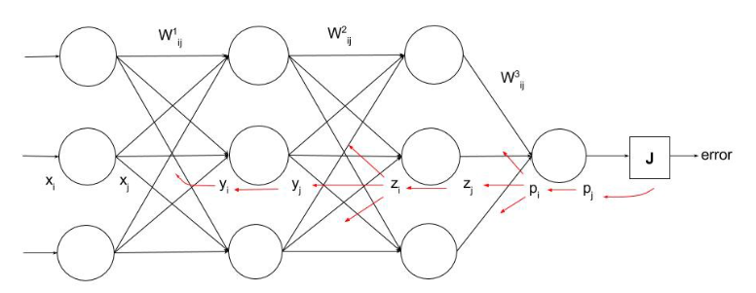
Backpropagation
https://ayearofai.com/rohan-lenny-1-neural-networks-the-backpropagation-algorithm-explained-abf4609d4f9d

Slide 9
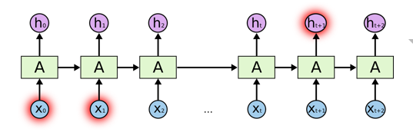
RNN
colah.github.io/posts/2015-08-Understanding-LSTMs

Slide 10
NEOCORTEX
Learning from brain

Slide 11

Brain
Neocortex
(rational)
Limbic
(emotional)
Reptilian
(instinctual)
http://siimland.com/what-to-feed-your-neocortex-to-boost-brain-power/
https://www.shutterstock.com/video/clip-540940-stock-footage--d-render-xray-style-image-of-the-human-brain-hd.html

Slide 12

Neuron

Slide 13
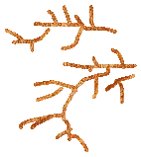
Neuron

Slide 14
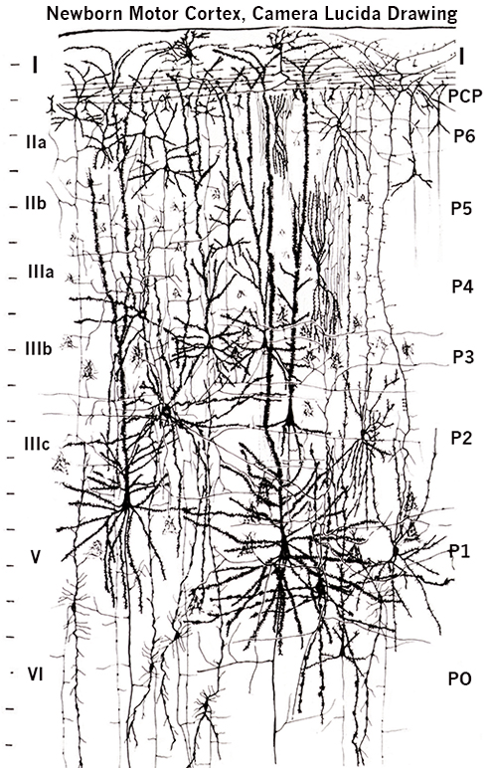
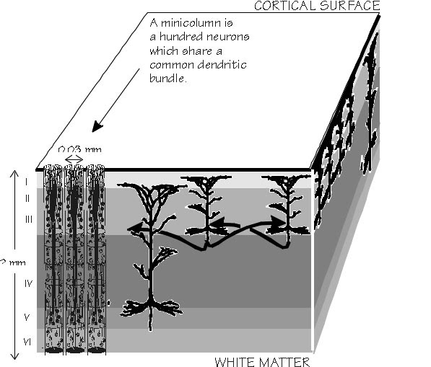
Layers and columns in neocortex
by Santiago Ramón y Cajal (1852-1934)
https://academic.oup.com/brain/article/125/5/935/328135

Slide 15
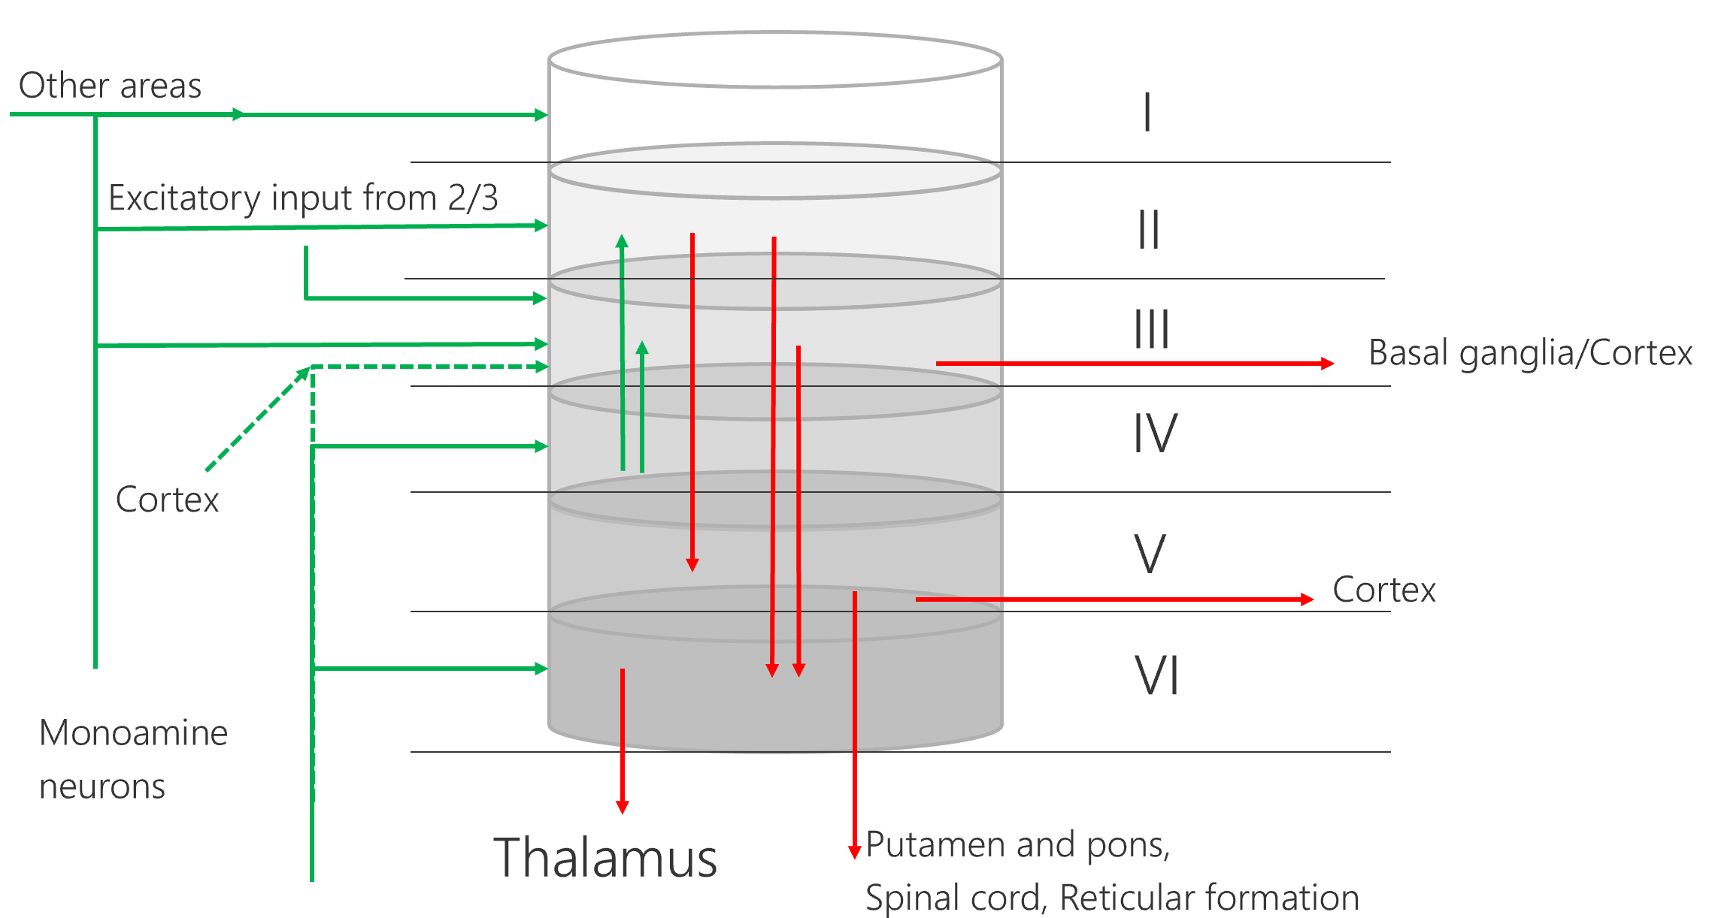
Model of a cortical column

Slide 16
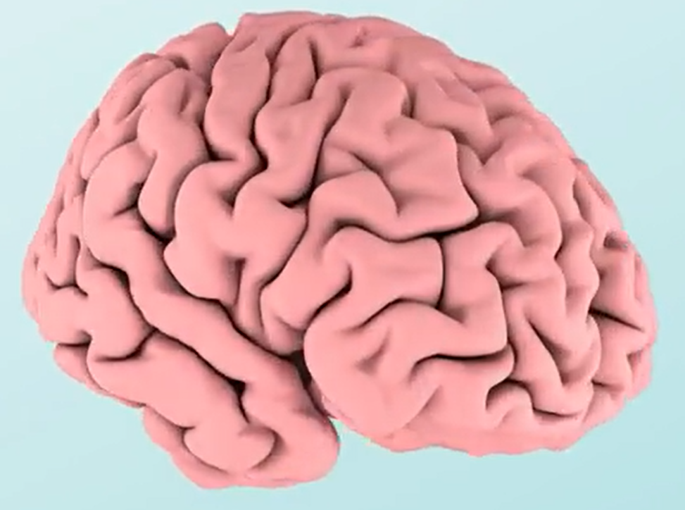

Layers and columns in neocortex

Slide 17
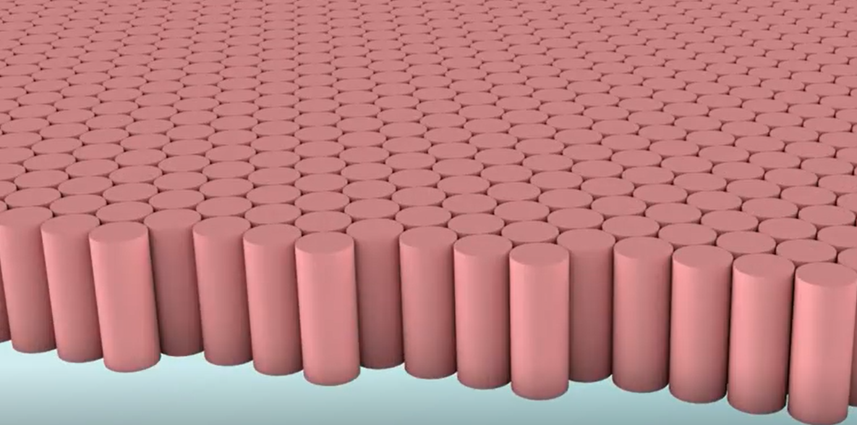
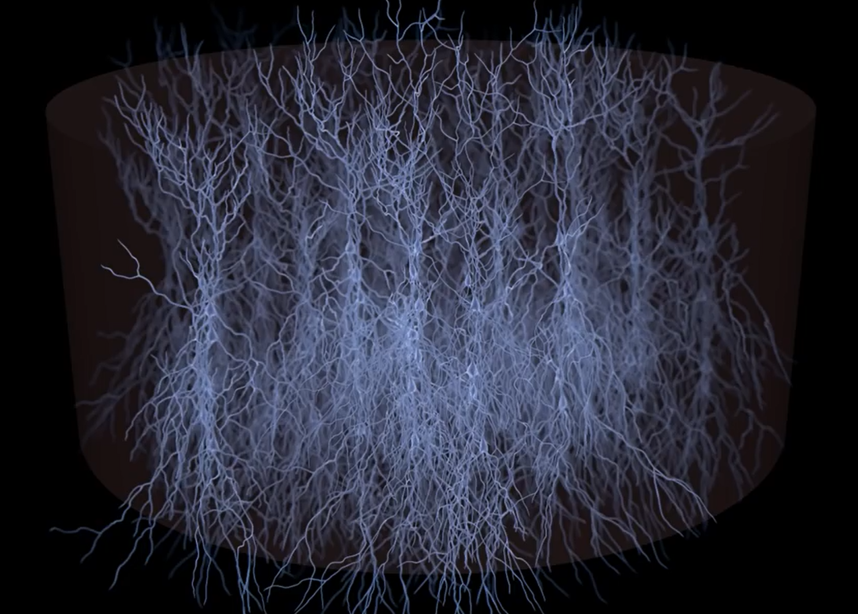
Cortical column with mini-columns
Video

Slide 18
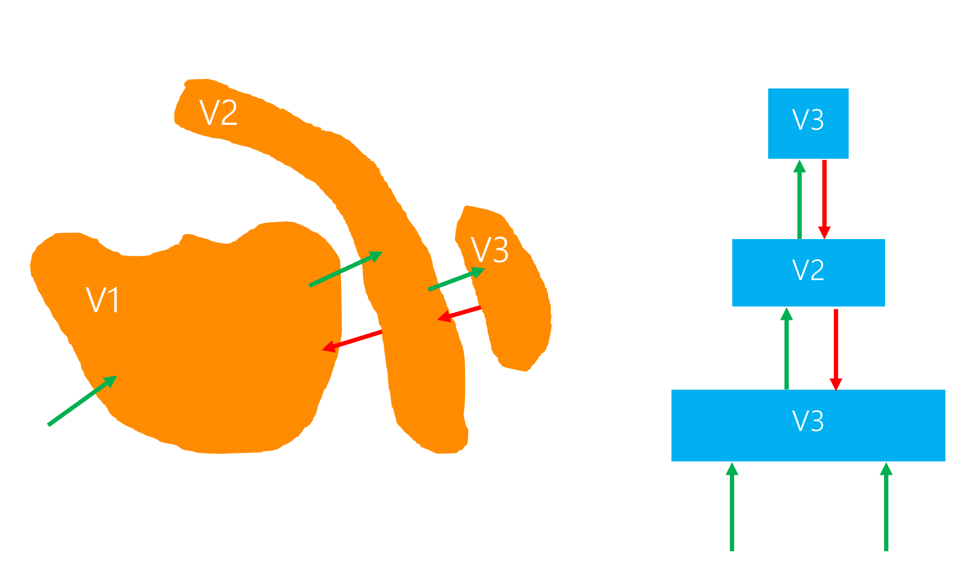
Hierarchical Semantic Layers

Slide 19
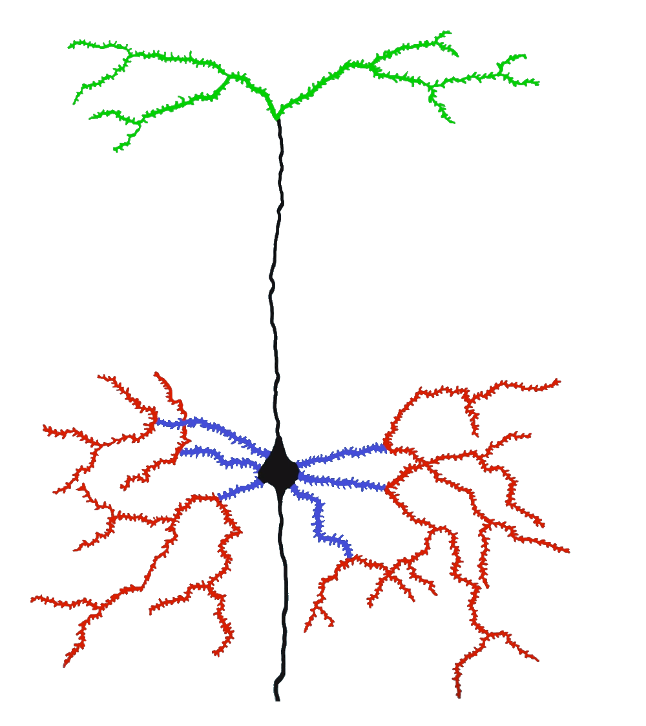
Hierarchical Temporal Memory Cortical Algorithm
Inspired by Neocortex
Different model of artifficial neuron
Dynamic Synapse grow
Inhibition
Boosting (homeostatic elasticity)
Two algorithms
Spatial Pooler
Temporal Memory
Feedback (apical)
Context (distal)
Feedforward (proximal)

Slide 20
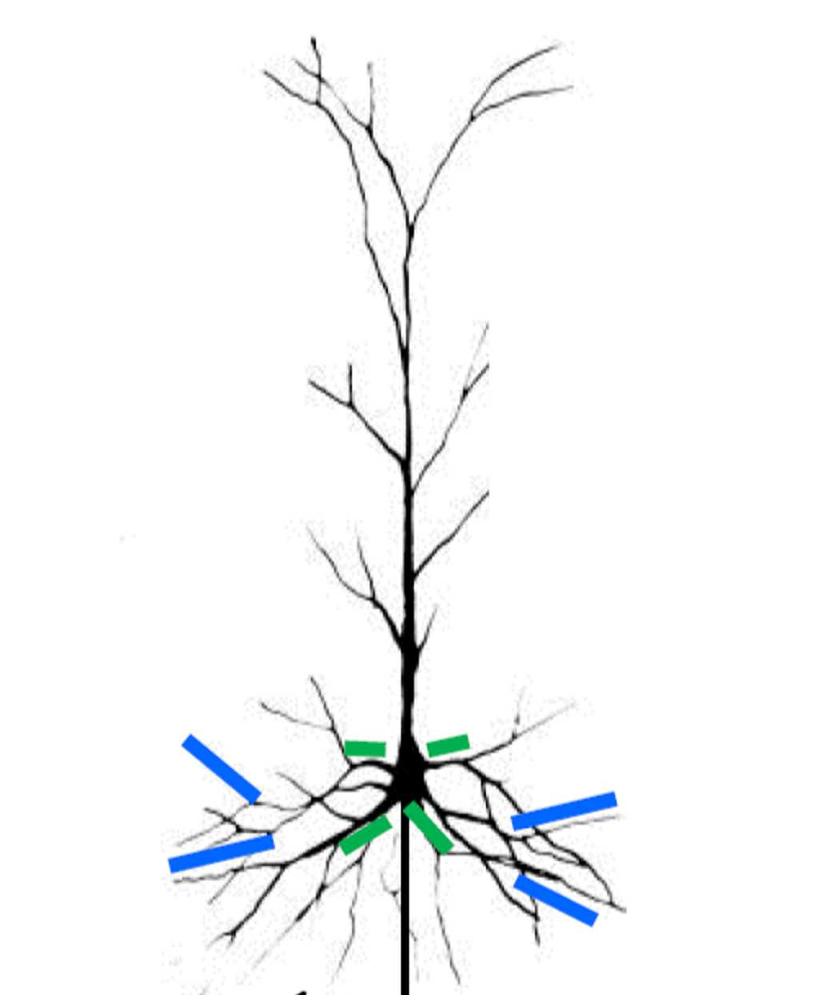
Neural Cell Model
Postsynaptic cell
Owner of the segment
Distal Dendrite Segment
Presynaptic cell
Receptor Synapses

Slide 21
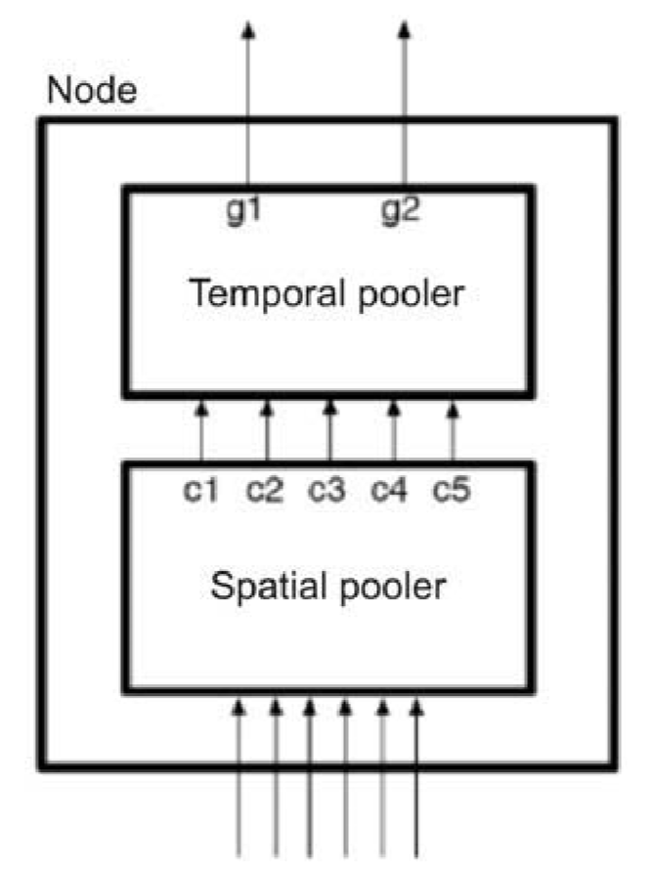
HTM CLA two algorithms
Spatial Pooler
Temporal Memory (Temporal Pooler is the old name)
Encoder

Slide 22
The column with SP and TM
Mini-columns
column
Temporal Memory
Spatial Pooler
Sensory input
0
0
0
1
1
1
0
1

Slide 23
NeocortexApi
https://github.com/ddobric/neocortexapi

Slide 24
ENCODER

Slide 25
What is an encoder?
HTM systems require data input in the form of Sparse Distributed Representations (SDRs)
SDR = Sparse Date Representation
An SDR is a large array of bits of which most are zeros and a few are ones.
First step of using an HTM system is to convert a data source into an SDR
https://pdfs.semanticscholar.org/1455/2052a0ee729539298e4f8eb42292c0eb1622.pdf

Slide 26
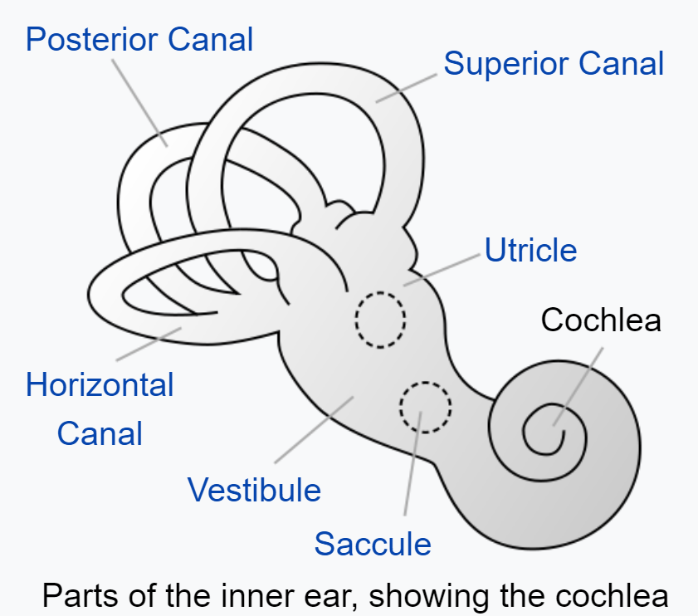
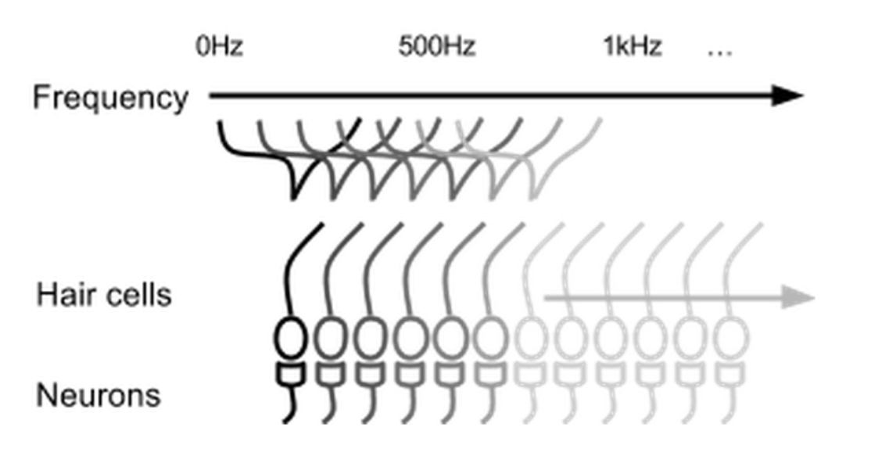

Parts of inner ear - Cochlea
Cochlear hair cells stimulate a set of neurons based on the frequency of the sound.

Slide 27
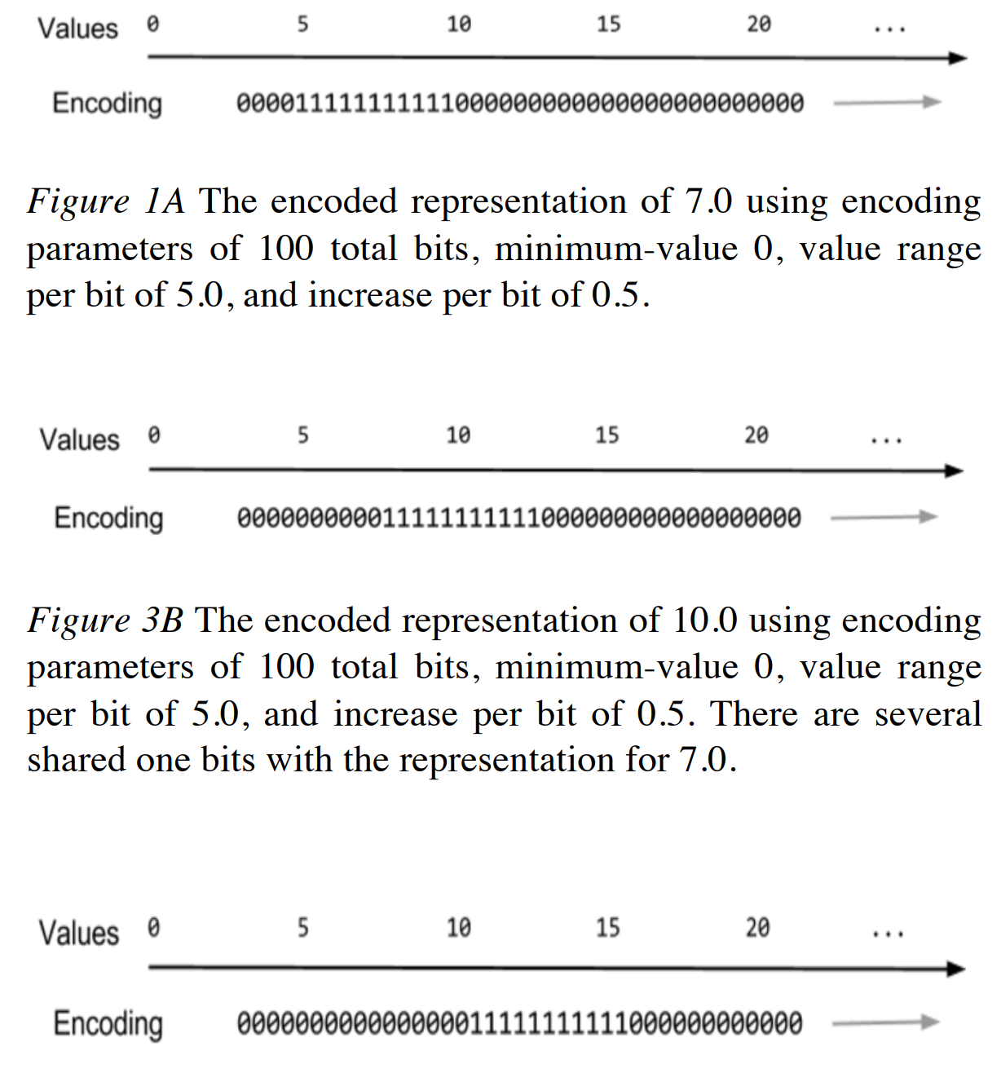
Encoding of scalar values

Slide 28
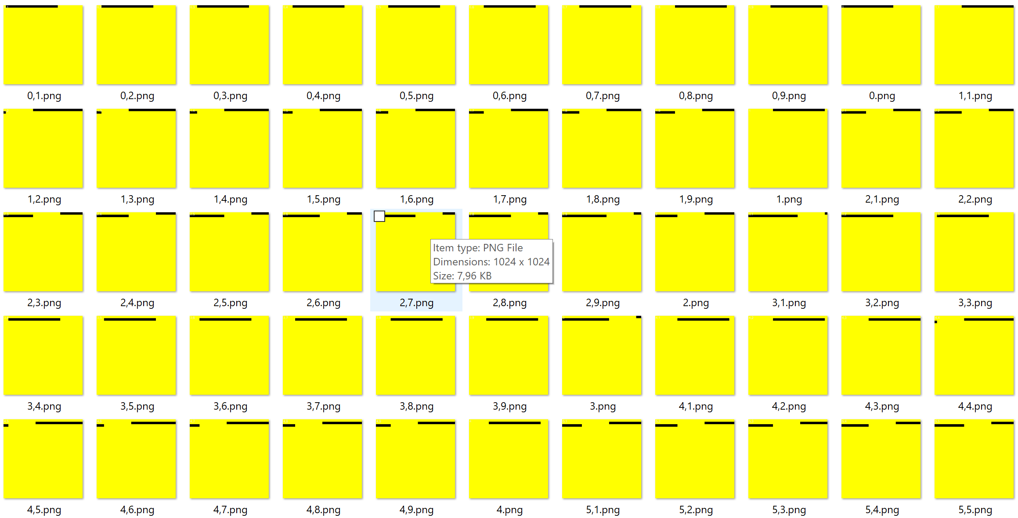
Example: Encoding of scalar values

Slide 29
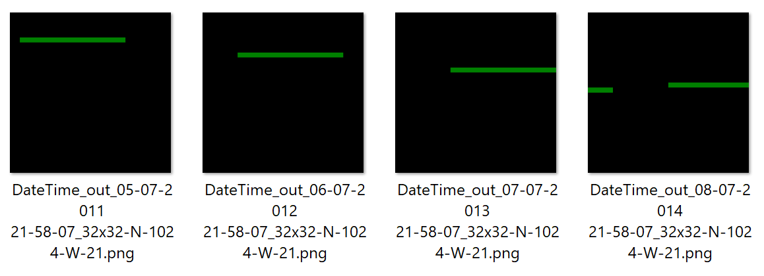
DateTime encoder

Slide 30

Definitions

Slide 31

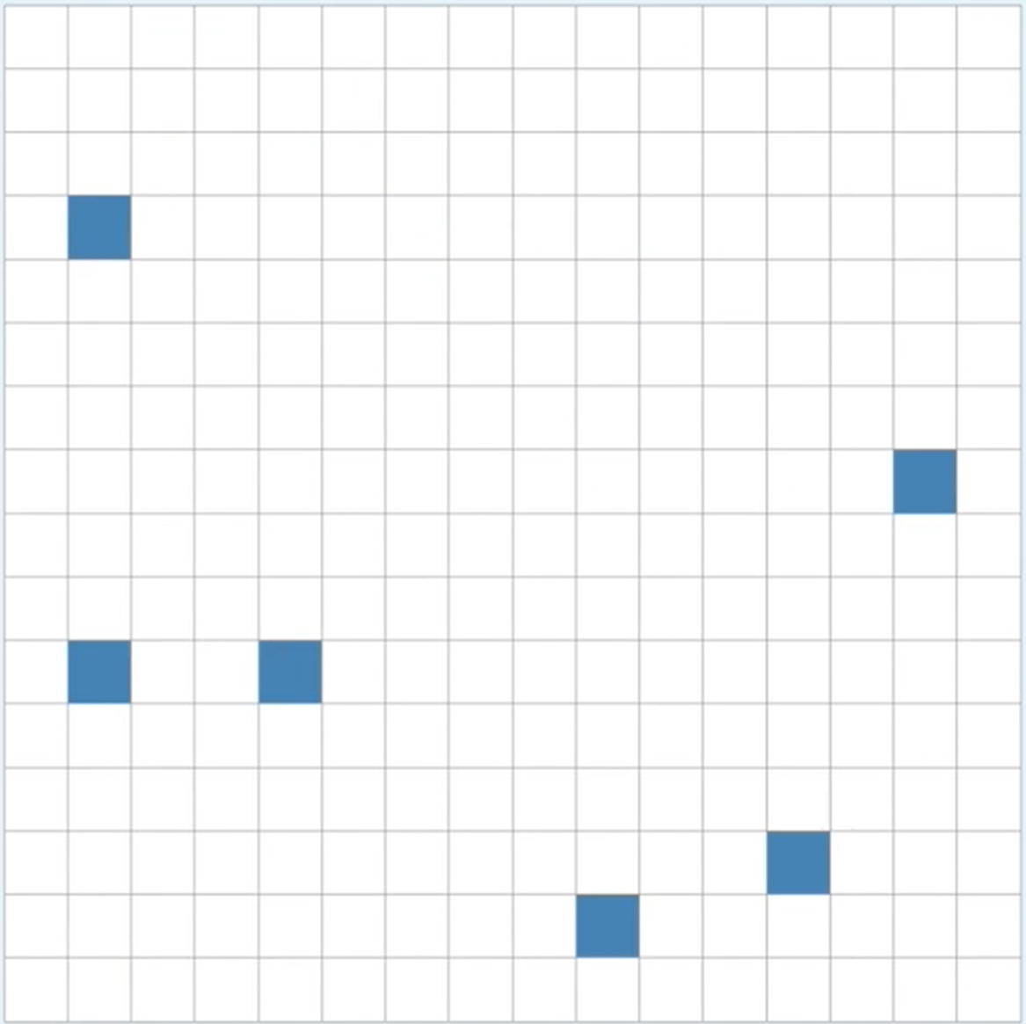
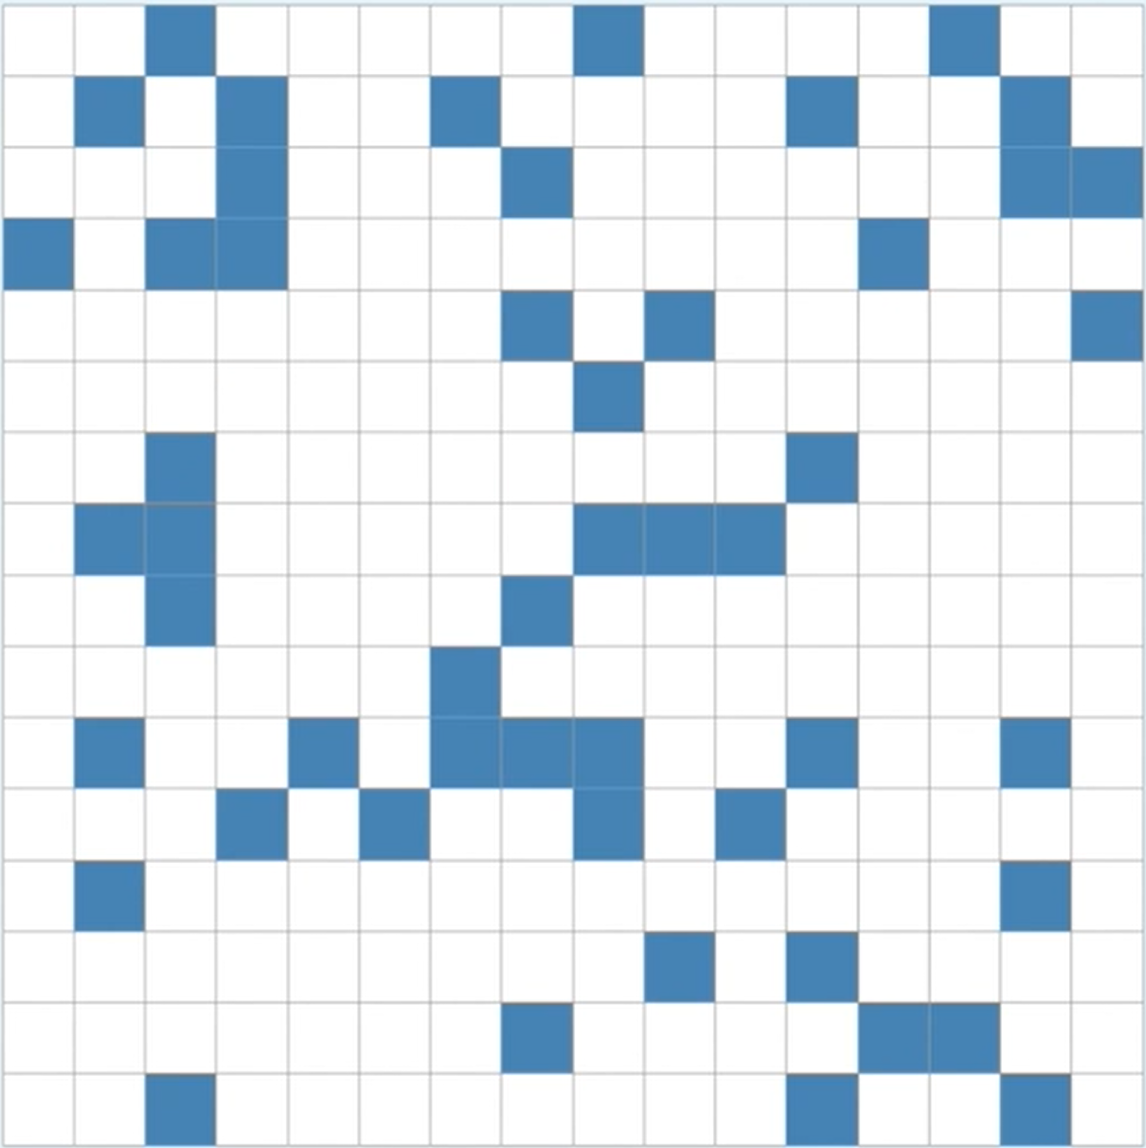
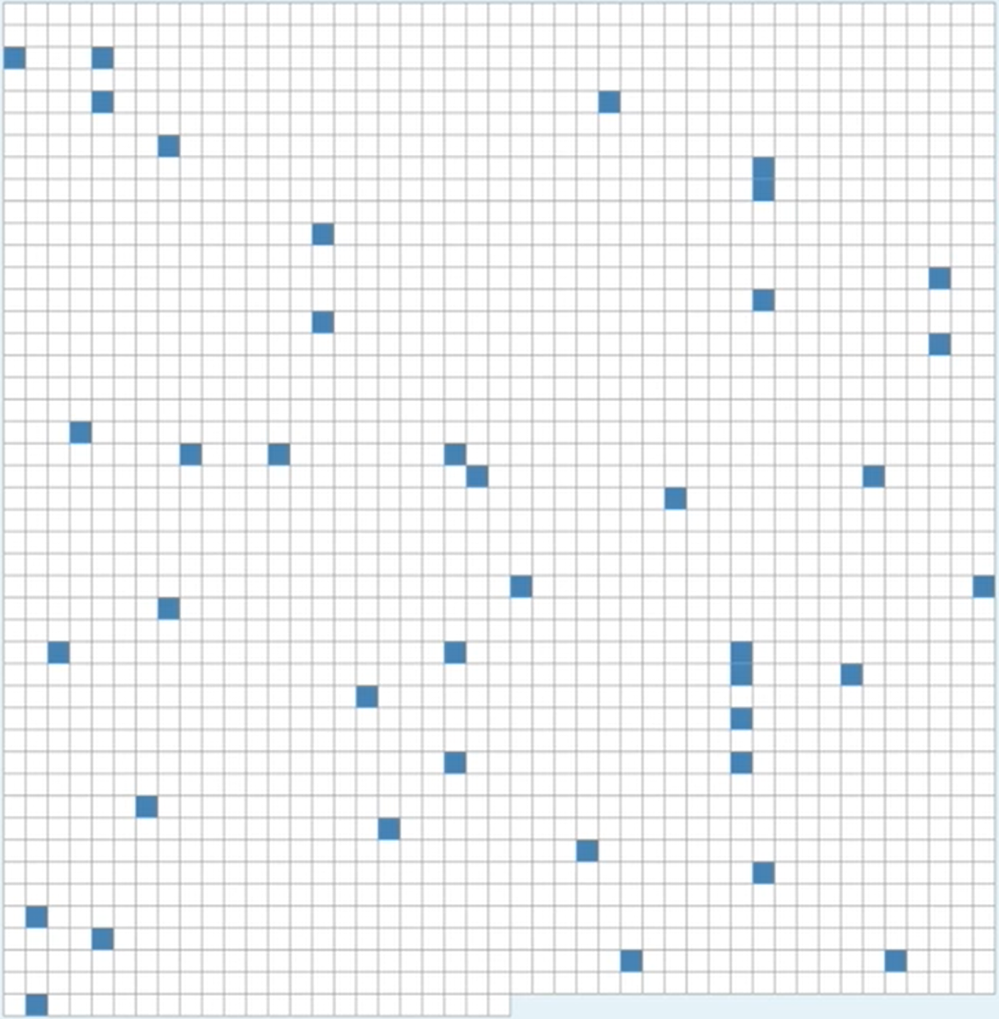
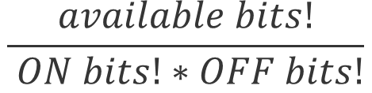
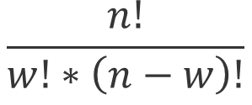
Capacity and Density
n = 16 w = 0 d = 0 c = 1
n = 16 w = 1 d =0.0625 c = 16
n = 16 w = 2 d =0.125 c = 120
n = 256 w = 6 d =0.0234 c =368532892176
n = 256 w = 51 d =0.192 c ~ 2034388346E45
n = 2048 w = 40 d =0.0195 c ~ 2371E81
$$\frac{available bits!}{ ON bits!∗OFF bits!}$$
$$\frac{n!}{w!∗\left(n−w\right)!}$$

Slide 32
Using encoder
ScalarEncoder encoder = new ScalarEncoder(new Dictionary<string, object>()
{
{ "W", 21},
{ "N", 1024},
{ "Radius", -1.0},
{ "MinVal", 0.0},
{ "MaxVal", 100.0 },
{ "Periodic", false},
{ "Name", "scalar"},
{ "ClipInput", false},
});
var result = encoder.Encode(i);
int[,] twoDimenArray = ArrayUtils.Make2DArray<int>(result, (int)Math.Sqrt(result.Length), (int)Math.Sqrt(result.Length));
var twoDimArray = ArrayUtils.Transpose(twoDimenArray);
NeoCortexUtils.DrawBitmap(twoDimArray, 1024, 1024, $"{outFolder}\\{i}.png", Color.Yellow, Color.Black, text:i.ToString());

Slide 33
SPATIAL POOLER

Slide 34
What is the Spatial Pooler?
It creates the SDR code of the given input

Slide 35
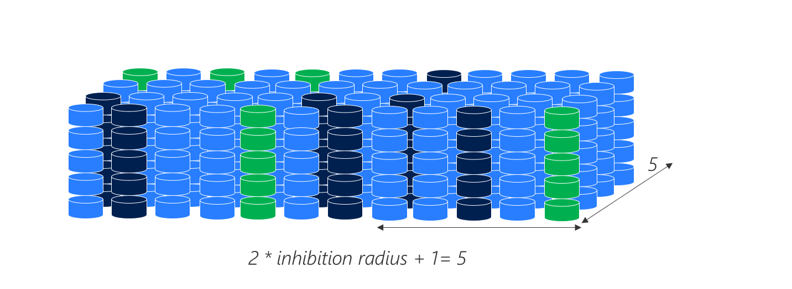
3D representation of the column with mini-columns

Slide 36
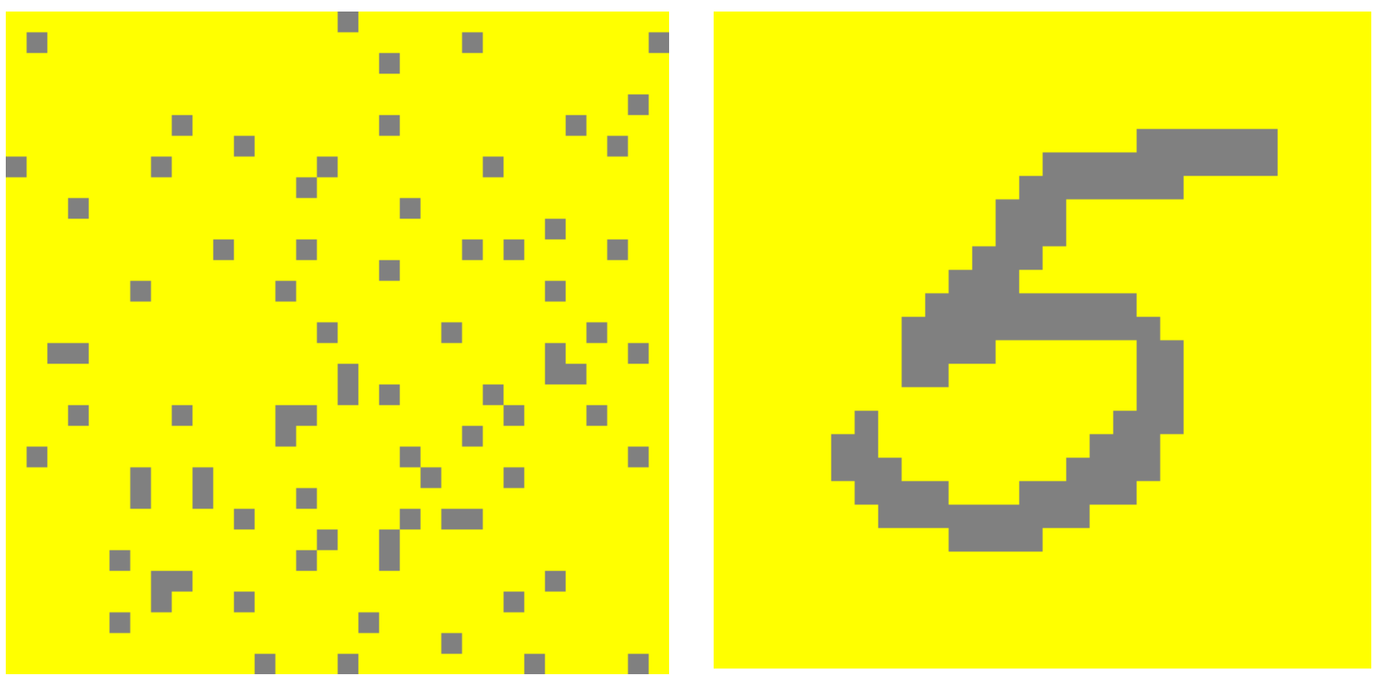
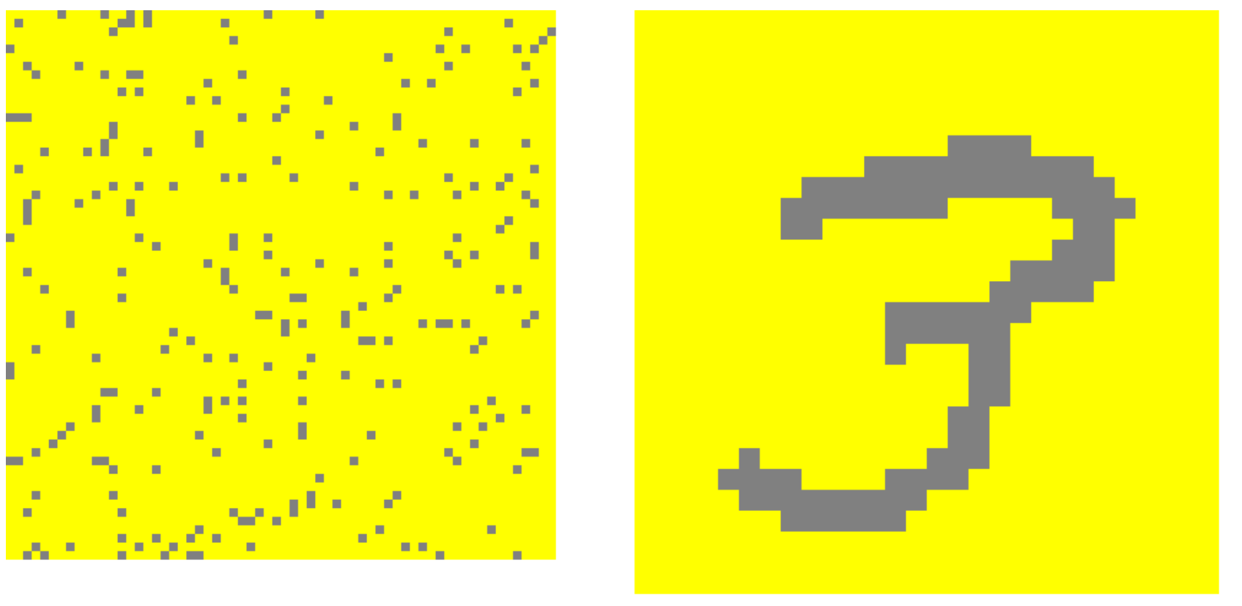
MNIST image of digits
SDR code of ‘5’
input
SDR code of ‘3’
input

Slide 37
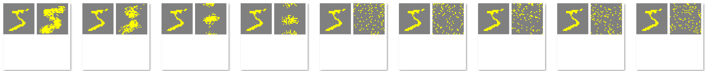
Inhibition Radius
10%
90%

Slide 38
Konfiguration
var htmConfig = new HtmConfig()
{
InputDimensions = new int[] { 5 },
ColumnDimensions = new int[] { 5 },
PotentialRadius = 5,
PotentialPct = 0.5,
GlobalInhibition = false,
LocalAreaDensity = -1.0,
NumActiveColumnsPerInhArea = 3.0,
StimulusThreshold = 0.0,
SynPermInactiveDec = 0.01,
SynPermActiveInc = 0.1,
SynPermConnected = 0.1,
MinPctOverlapDutyCycles = 0.1,
MinPctActiveDutyCycles = 0.1,
DutyCyclePeriod = 10,
MaxBoost = 10,
RandomGenSeed = 42,
Random = new ThreadSafeRandom(42),
};

Slide 39
Do not use this config!
public void SpatialSequenceLearningExperiment()
{
var parameters = GetDefaultParams();
parameters.Set(KEY.POTENTIAL_RADIUS, 64 * 64);
parameters.Set(KEY.POTENTIAL_PCT, 1.0);
parameters.Set(KEY.GLOBAL_INHIBITION, false);
parameters.Set(KEY.STIMULUS_THRESHOLD, 0.5);
parameters.Set(KEY.INHIBITION_RADIUS, (int)0.25 * 64 * 64);
parameters.Set(KEY.LOCAL_AREA_DENSITY, -1);
parameters.Set(KEY.NUM_ACTIVE_COLUMNS_PER_INH_AREA, 0.1 * 64 * 64);
parameters.Set(KEY.DUTY_CYCLE_PERIOD, 1000000);
parameters.Set(KEY.MAX_BOOST, 5);
parameters.setInputDimensions(new int[] { 32, 32 });
parameters.setColumnDimensions(new int[] { 64, 64 });
parameters.setNumActiveColumnsPerInhArea(0.02 * 64 * 64);
var sp = new SpatialPooler();
var mem = new Connections();
double[] inputSequence = new double[] { 1.0, 2.0, 3.0, 4.0, 5.0, 6.0, 7.0 };
var inputVectors = GetEncodedSequence(inputSequence, 0.0, 100.0);
parameters.apply(mem);
sp.init(mem);
. . .
}

Slide 40
Using Spatial Pooler
HtmConfig htmConfig = SetupHtmConfigParameters();
mem = new Connections(htmConfig);
sp = new SpatialPoolerMT(); //sp = new SpatialPooler();
sp.Init(mem);

Slide 41
Using SpatialPooler
public void SpatialSequenceLearningExperiment()
{
. . .
parameters.apply(mem);
sp.init(mem);
foreach (var inputVector in inputVectors)
{
for (int i = 0; i < 3; i++)
{
var activeArray = sp.Compute(inputVector, true) as int[];
var activeCols = ArrayUtils.IndexWhere(activeArray, (el) => el == 1);
var str = Helpers.StringifyVector(activeCols);
Debug.WriteLine(str);
}
}
}

Slide 42
SpatialPooler Compute() nethod
var activeIndicies = sp.Compute(inputVector, true, true) as int[];
var activeArray = sp.Compute(inputVector, true, false) as int[];
Debug.WriteLine(Helpers.StringifyVector(activeArray));
Debug.WriteLine(Helpers.StringifyVector(activeIndicies));
2,3,..
0,0,1,1,0,0..

Slide 43
Examples for Spatial Pooler
All tests are implemented in project: UnitTestsProject
SP Tests:
Experiments: SpatialPoolerResearchTests
UnitTests: SpatialPoolerTests
Sample: SpatialPatternLearning

Slide 44
TEMPORAL MEMORY

Slide 45
Examples for Temporal Memory
All tests are implemented in project: UnitTestsProject
Temporal Memory Tests:
Experiments: NetworkTests.cs
UnitTests: TemporalMemoryTests.cs
Sample: MultiSequenceLearning.cs

Slide 46
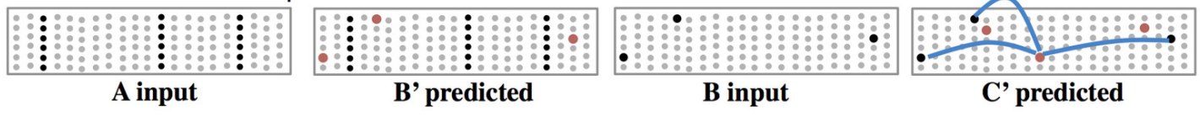
Layers Model & Sequence Memory

Slide 47
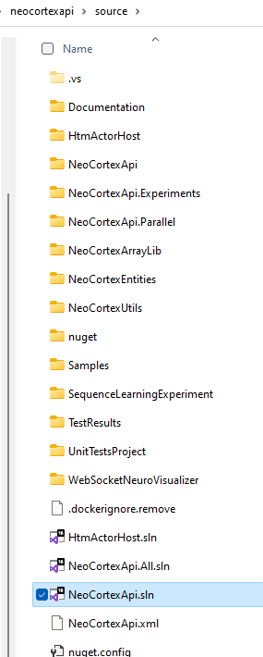
Exercise XII
Working with Spatial Pooler
Tutorial https://github.com/ddobric/neocortexapi/blob/master/source/Documentation/tutorial.md
Getting started https://github.com/ddobric/neocortexapi/blob/master/source/Documentation/gettingStarted.md
Spatial pooler experiment example https://github.com/ddobric/neocortexapi/blob/master/source/Samples/NeoCortexApiSample/SpatialPatternLearning.cs
Working with Temporal Memory https://github.com/ddobric/neocortexapi/blob/master/source/Samples/NeoCortexApiSample/SequenceLearning.cs
Analysing SDRs neocortexapi/ColumnActivity.md at master · ddobric/neocortexapi (github.com)
Read references (next slide)

Slide 48
Global Inhibition
5
2 * inhibition radius + 1= 5

Slide 49
Average Span of connected synapses
Min = {1}
Max = {8}
Average = (8-1)/2=3.5
MinX =0, MinY=0
MaxX = 4, MaxY=1
Average((4-0),(1-0))=
(4-1)/2=1.5
1
1
0
0
0
0
0
0
0
1
0
Sensory input
0
0
1
0
0
1
0
0
0
1
0
0
1
0
0
1
0
0
0
1
0
0
4
9

Slide 50

Local Inhibition example
Inhibition Radius = 2, threshold = 0, density=0.5
act = (int)(0.5 + density * neighborhood.Length);
Two higher than 1.0
(0) Winners={}, act=2
1.0
2.0
7.0
0.0
3.0
4.0
16
1.0
1.5
1.7
One higher than 2
(1) Winners={1}, act=2
1.0
2.0
7.0
0.0
3.0
4.0
16
1.0
1.5
1.7
No higher than 7.0
(2) Winners={1,2}, act=3
1.0
2.0
7.0
0.0
3.0
4.0
16
1.0
1.5
1.7
Four higher than 0.0
(3) Winners={1,2}, act=3
1.0
2.0
7.0
0.0
3.0
4.0
16
1.0
1.5
1.7
Three higher than 0.0
(4) Winners={1,2}, act=3
1.0
2.0
7.0
0.0
3.0
4.0
16
1.0
1.5
1.7

Slide 51
Local Inhibition example continue
Inhibition Radius = 2, threshold = 0, density=0.5
act = (int)(0.5 + density * neighborhood.Length);
One with higher than 4.0
(5) Winners={1,2,5}, act=3
1.0
2.0
7.0
0.0
3.0
4.0
16
1.0
1.5
1.7
No higher than 16
(6) Winners={1,2,5,6},act=3
1.0
2.0
7.0
0.0
3.0
4.0
16
1.0
1.5
1.7
Four higher than 1.0
(7) Winners={1,2,5,6},act=3
1.0
2.0
7.0
0.0
3.0
4.0
16
1.0
1.5
1.7
Two higher than 1.5
(8) Winners={1,2,5,6},act=3
1.0
2.0
7.0
0.0
3.0
4.0
16
1.0
1.5
1.7
One higher than 1.7
(9) Winners={1,2,5,6,9},act=3
1.0
2.0
7.0
0.0
3.0
4.0
16
1.0
1.5
1.7

Slide 52
Local Inhibition – Top view on columns

Slide 53
Column Global Inhibition algorithm
Num of columns = 10
Density = 20% => 2 columns can be inhibited.
Chose 2 columns with highest overlap: o(k)
o(0) = 4, o(1) = 0, o(2) = 3 => active columns = {0,2}
c0
c1
c9
0
0
0
0
0
0
0
1
1
1
0
1
1
0
0
0
0
0
1
0

Slide 54
Column Local Inhibition algorithm
Num of columns = 10
Inhibition radius = 2. Means 5 columns can be reached.
Density = 50% =>50% of 5 reached columns can be inhibited =>2-5
Now calculate N: num of cols with bigger overlap then focusing col.
Focus col=0, span 0,1,2=3, 50% of (3)+0.5 = (int)2, N=2 {1,2}/[2,7] (-)
Focus col=1, span 0,1,2,3=4, 50% of (3)+0.5 = (int)2, N=1 {1}/[7]<2 (+)
Focus col=2,span 0,1,2,4=4, 50% of (2)+0.5 = (int)3, N=0 {2,7}<2 (+)
1 2 7 0 3 4 16 1 1.5 1.7

Slide 55
MATH C#
---------------------------------------------------------------
x1 = {1.2, 2.8, 3.5} | var x1 = new double[] {1.2, 2.8, 3.5}
x2 = {1.2, 2.5, 2.9} | var x1 = new double[] {1.2, 2.5, 2.9}
xN
----------------------------------------------------------------
double[][] inputVectors = new double[N][];
inputVectors[0] = x1;
inputVectors[1] = x2;
...
inputVectors[N] = xN;
--- Another way ------------
List<double[]> inputVectors = List<double[]>();
inputVectors.Add(x1);
inputVectors.Add(x2);
..
inputVectors.Add(xN);

Slide 56
References
https://www.youtube.com/watch?v=Ub1fE-bAroA
https://en.wikipedia.org/wiki/Hierarchical_temporal_memory
https://www.youtube.com/watch?v=nBYddmFg4nQ
https://web.archive.org/web/20110714212402/http://www.numenta.com/htm-overview/education.php
Spatial Pooling Algorithm Details (numenta.com)

Slide 57
Publications
International Journal of Artificial Intelligence and Applications:
https://aircconline.com/abstract/ijaia/v11n4/11420ijaia07.html
10.5121/ijaia .2020.11407
AIS 2020 - 6th International Conference on Artificial Intelligence and Soft Computing, Helsinki
https://aircconline.com/csit/csit1006.pdf
10.5121/csit.2020.100605
Symposium on Pattern Recognition and Applications, Nov. 6 - 8, 2020 @ Rome
https://doi.org/10.1145/3393822.3432317
https://dl.acm.org/doi/10.1145/3393822.3432317
10.1145/3393822.3432317
ICPRAM Vienna 2021 (Award Winner Paper)
Improved HTM Spatial Pooler with Homeostatic Plasticity control
https://www.scitepress.org/PublicationsDetail.aspx?ID=fUz607CA/eU=&t=1
Improved HTM Spatial Pooler with Homeostatic Plasticity Control - ICPRAM 2021 (insticc.org) 10.5220/0010314200980106
Springer Nature Computer Science Journal
https://www.springer.com/journal/42979/updates/17257234

Slide 58

Thank You

